Slide 1
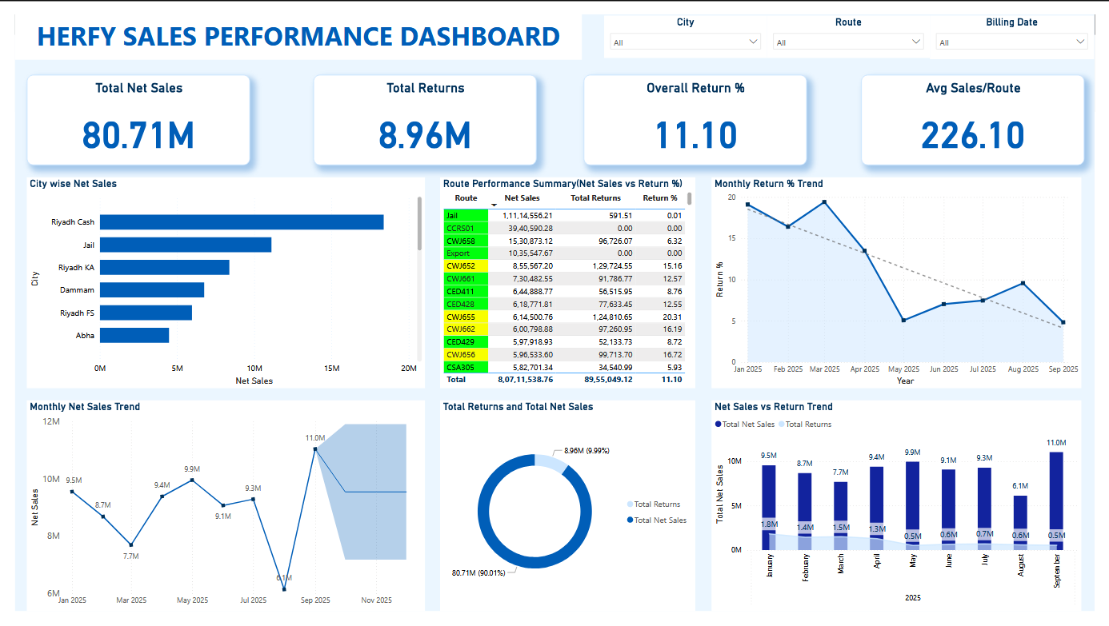
HERFY SALES ANALYSIS REPORT
Prepared by : Hidha Nourin
Data Analyst
Date : 6th December 2025
Tools Used: Power BI | Excel | PowerPoint

Slide 2
KEY KPIs & PERFORMANCE SUMMARY
Overall Performance Summary
KPIs :
Total Net Sales : 80.71M SAR
Total Returns : 8.96M SAR
Return % : 11.10%
Average Sales per Route : 226.10K SAR
Key Insights :
Net Sales remain strong across major locations, especially in Riyadh regions.
Return percentage above 10% indicates operational improvement opportunities.
Highest revenue contribution comes from central routes and cash based locations.
Several routes maintain consistent performance with low return amounts.

Slide 3
CITY & ROUTE PERFORMANCE
City & Route Performance Analysis
City Insights:
Top cities : Riyadh Cash, Jail, Riyadh KA
Lowest city : Hail
High concentration of sales in Riyadh indicates strong regional demand.
Route Insights:
Best Performing Routes : Export, CCRS02, CCRS01…
Routes Needing Attention : CCR163, CCR157, CCRV88…
High-return routes may need route optimization or quality checks.

Slide 4
Route Performance – Color Coding
🟩 Green – Best Performing Routes
Routes highlighted in green have high sales and very low return percentages.
These routes show strong efficiency, good product handling and high customer satisfaction.
🟨 Yellow – Moderate Performance
Yellow routes show medium return percentages.
Performance is acceptable but inconsistent, and these routes need monitoring and minor improvements.
🟥 Red – Routes Needing Immediate Attention
Red routes have high return percentages, indicating delivery issues, handling problems or customer dissatisfaction.
These routes pose a risk to profitability and require urgent investigation and correction.

Slide 5
MONTHLY TRENDS
MONTHLY SALES & RETURN TRENDS
Monthly Net Sales Trend (with Forecast)
Net Sales fluctuated throughout the year with noticeable dips in March and August.
Strong recovery observed in May and September.
Forecast indicates stable to moderate growth in the upcoming months.
Seasonal performance variations suggest planning opportunities for inventory and manpower.
Monthly Return % Trend
Return % dropped significantly from 19% in January to 5% in May.
This consistent decline shows improvement in operations and better route performance.
Slight rise in later months but overall remains below critical levels.

Slide 6
CONCLUSION
Herfy demonstrates strong overall sales performance driven by key cities like Riyadh and
efficient routes.
High return percentages in a few routes indicate areas for operational improvement.
Reduction in return % shows positive progress in quality control and route management.
Continued focus on low performing cities and high return routes can further increase profitability.
The forecast suggests stable sales, supporting confident decision-making for upcoming quarters.

Slide 7
THANK YOU

